Slide 1
Metagenomics Data Analysis
Bioinformatics group
KACST

Slide 2
Content:
Metagenomics definition & history.
Microbes.
Metagenomics Applications.
Metagenomics Data.
Metagenomics Analysis

Slide 3
What is Metagenomics ?
Metagenomics term was proposed by Jo Handelsman in 1998 during her work on the study of the antibiotic resistance.
Metagenomics is a non-culture based approach used to study of the collective genomes of the members of a microbial community that found in environment.

Slide 4
The Microbes Community:
The microbial community presents viruses, bacteria, fungi, and protists.
The microbes community exist in soil, oceans, oil and animals gut etc..
Microbes are essential for every part of human life.
Microbes have a major role in maintain and regulate the atmosphere.
Microbes are important for human health.

Slide 5
Metagenomics Applications:
To describe microbial communities in different systems.
To study the taxonomy and gene functions of the microbes in the environment.

Slide 6
Metagenomics and the Environment:
Microbes convert the key elements of life such as carbon, nitrogen & oxygen into forms accessible to all other organisms.
Microbes contribute in the photosynthetic.
Variety of microbes capable of living in extreme conditions environments.
Metagenomics allow us to identify unknown microbes and discover functional genes in these microbial communities.

Slide 7
Metagenomics and the Microbiota:
Human gut microbes involve in digest food, break down toxins, and fight off diseases.
The interaction between the host organisms and the microbiota has a significant impact on their immune systems.
The changes in the compositions of the diversity of gut microbes will involve in many in Inflammatory bowel diseases, type 2 diabetes and colorectal cancer.

Slide 8
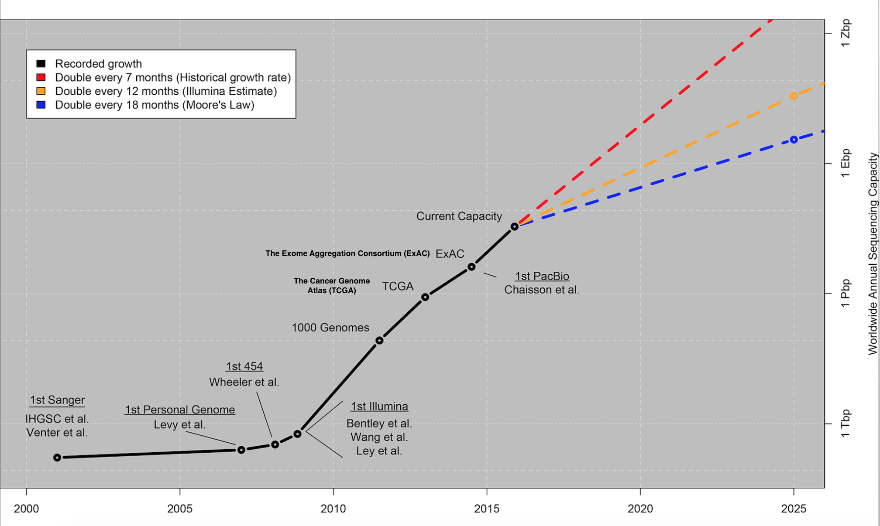
Metagenomics Data:

Slide 9
Metagenomics Lab Workflow:
DNA Extraction
16s ribosomal RNA
Library
Whole genome shotgun
Library
Next Generation Sequencing (NGS)
Library preparation

Slide 10
Library Preparation:
 | 16s rRNA library | Whole genome shotgun library
price | 150 – 250 Saudi Riyal per sample | 1200 – 1500 Saudi Riyal per sample
Taxonomy level | Genus level | Species level
Applications | Taxonomy analysis Phylogenetic analysis | Taxonomy analysis, Phylogenetic analysis and function analysis (Gene prediction & Biomarker discovery)

Slide 11
Library Preparation pros and cons:
Library Preparation | Advantages | disadvantages
16s library | Cheap Easy to do in the lab. Fast. | The taxonomy is limited to Genus level. Can not be used to study the functions of the genes. The classification of the data less accurate. (clustering at 98%)
Whole genome shotgun library | Accurate classification. The taxonomy at the species level and sometimes Subspecies. Study the functions of the genes. | Expensive. The lab work takes longer time. The assembly of the reads is super complicated and need to repeat the sample sequencing many times.

Slide 12
Metagenomics 16s rRNA Analysis Workflow:
Preprocessing
Mapping
OTU Clustering
Statistical analysis

Slide 13
Stage 1 - Preprocessing:
In this stage the reads will be checked for quality and will be trimmed if needed and the adaptors must be removed.
Quality check : Fastqc tool
Trimming: Sickle tool
Cutting Adaptors: Cutadap tools

Slide 14
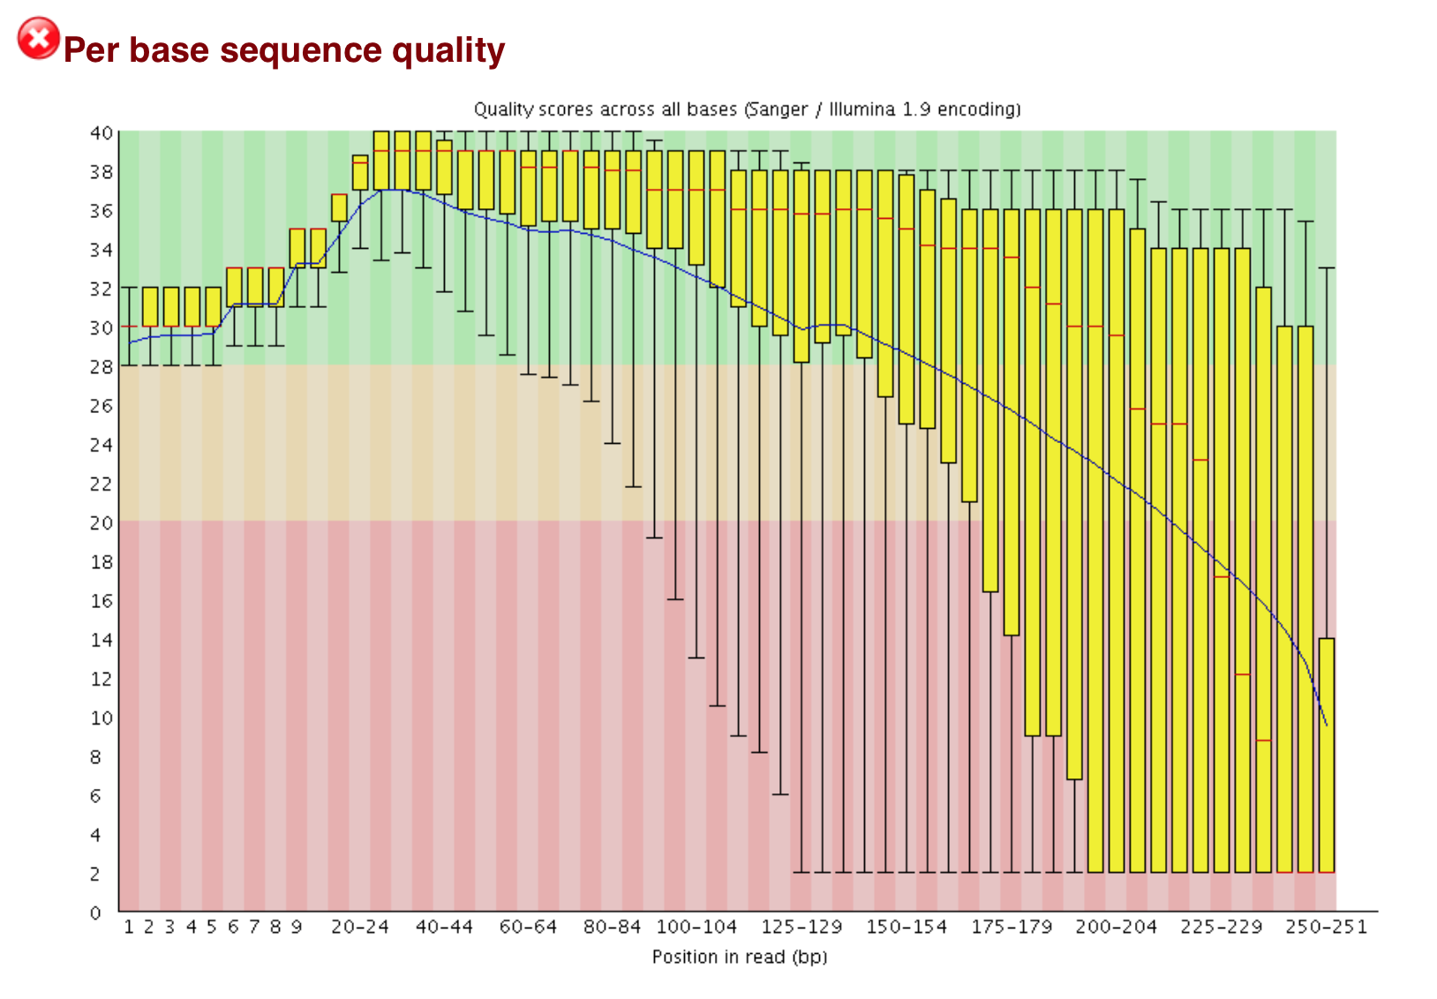
Before the preprocessing:

Slide 15
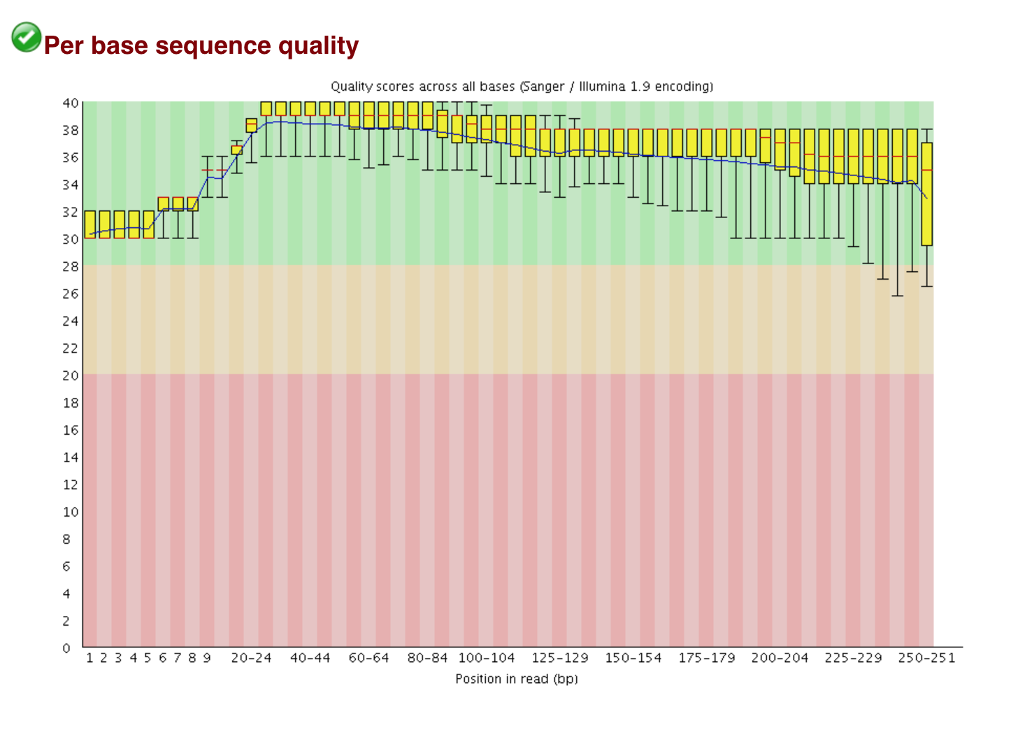
After the preprocessing:

Slide 16
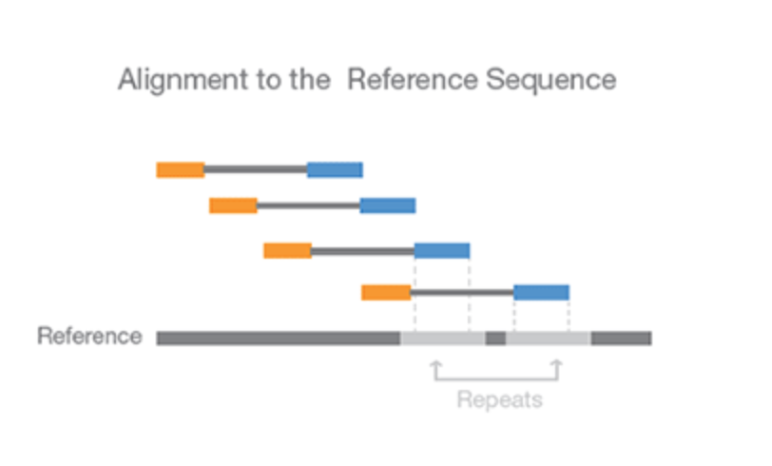
Stage 2 - Mapping:
16s rRNA reads will be aligned to 16s databases such as SLIVA or Greengenes.
For mapping you can use:
Mothur pipeline.
Qiime pipeline.

Slide 17
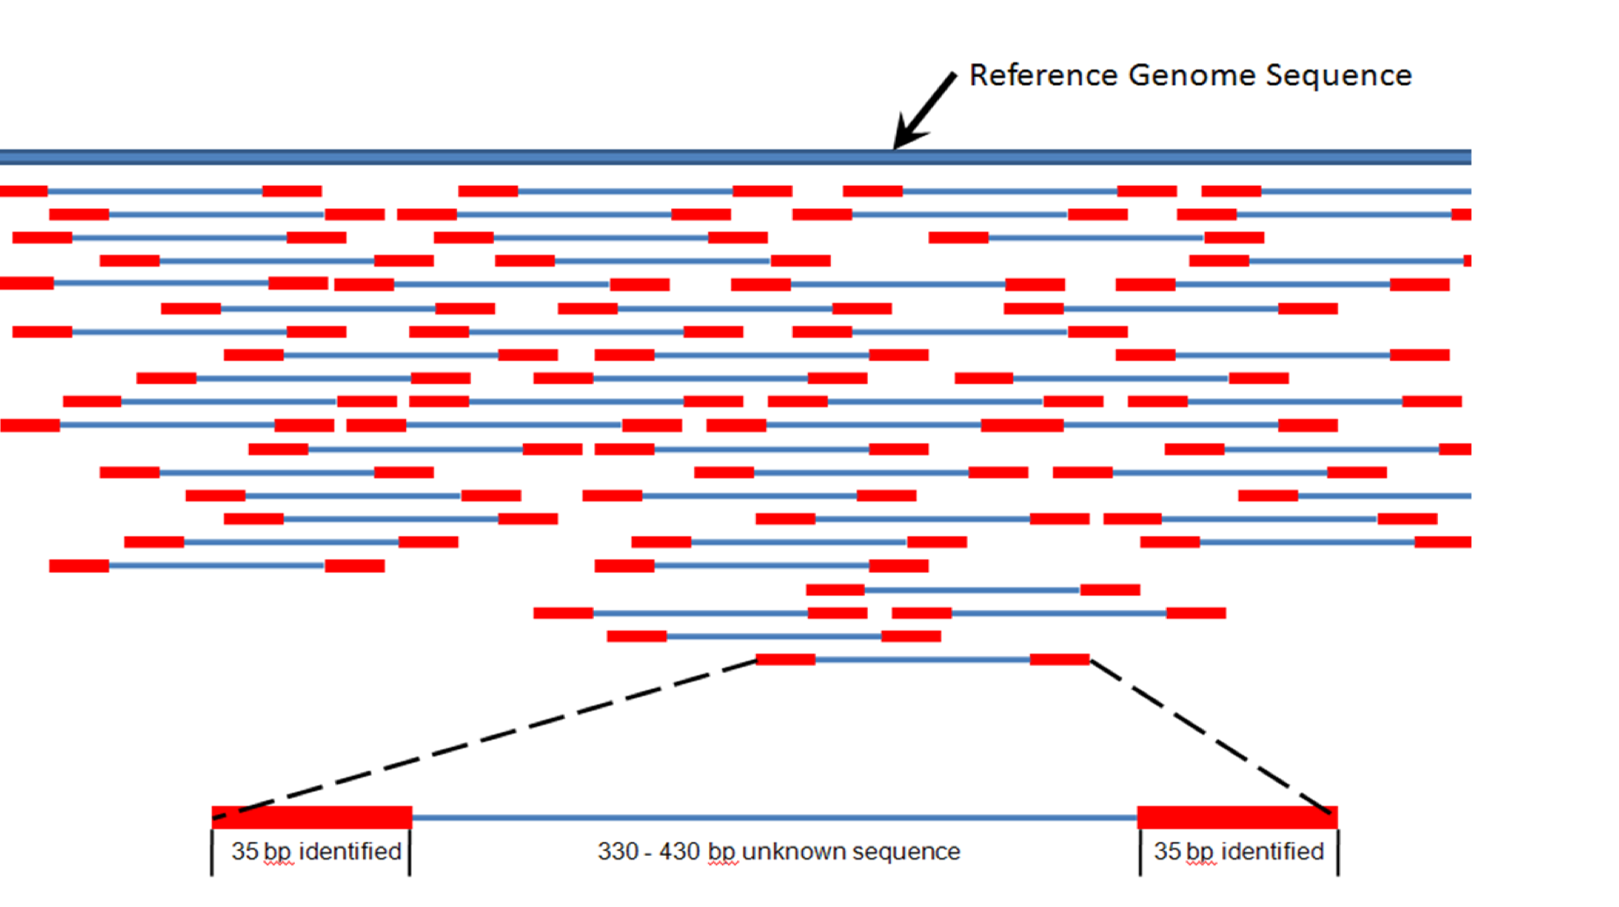
Mapping process:

Slide 18
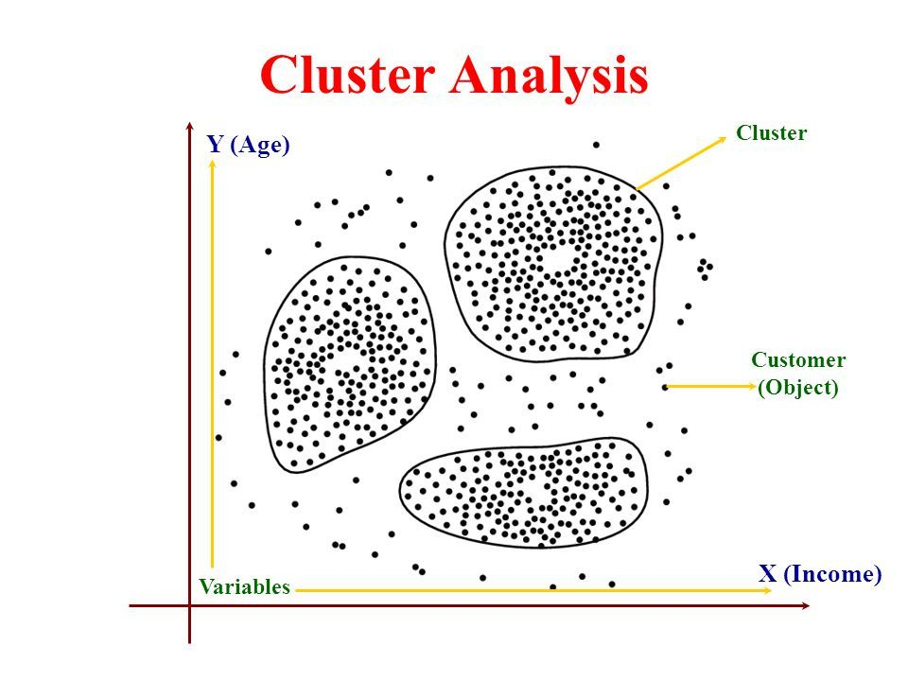
Stage 3 - OUT (Operational Taxonomic Unit) Clustering:
After finishing the alignment for the reads (Mapping) now the reads are ready to be classified by using OUT clustering analysis.
For OUT clustering you can use:
Mothur pipeline.
Qiime pipeline.

Slide 19
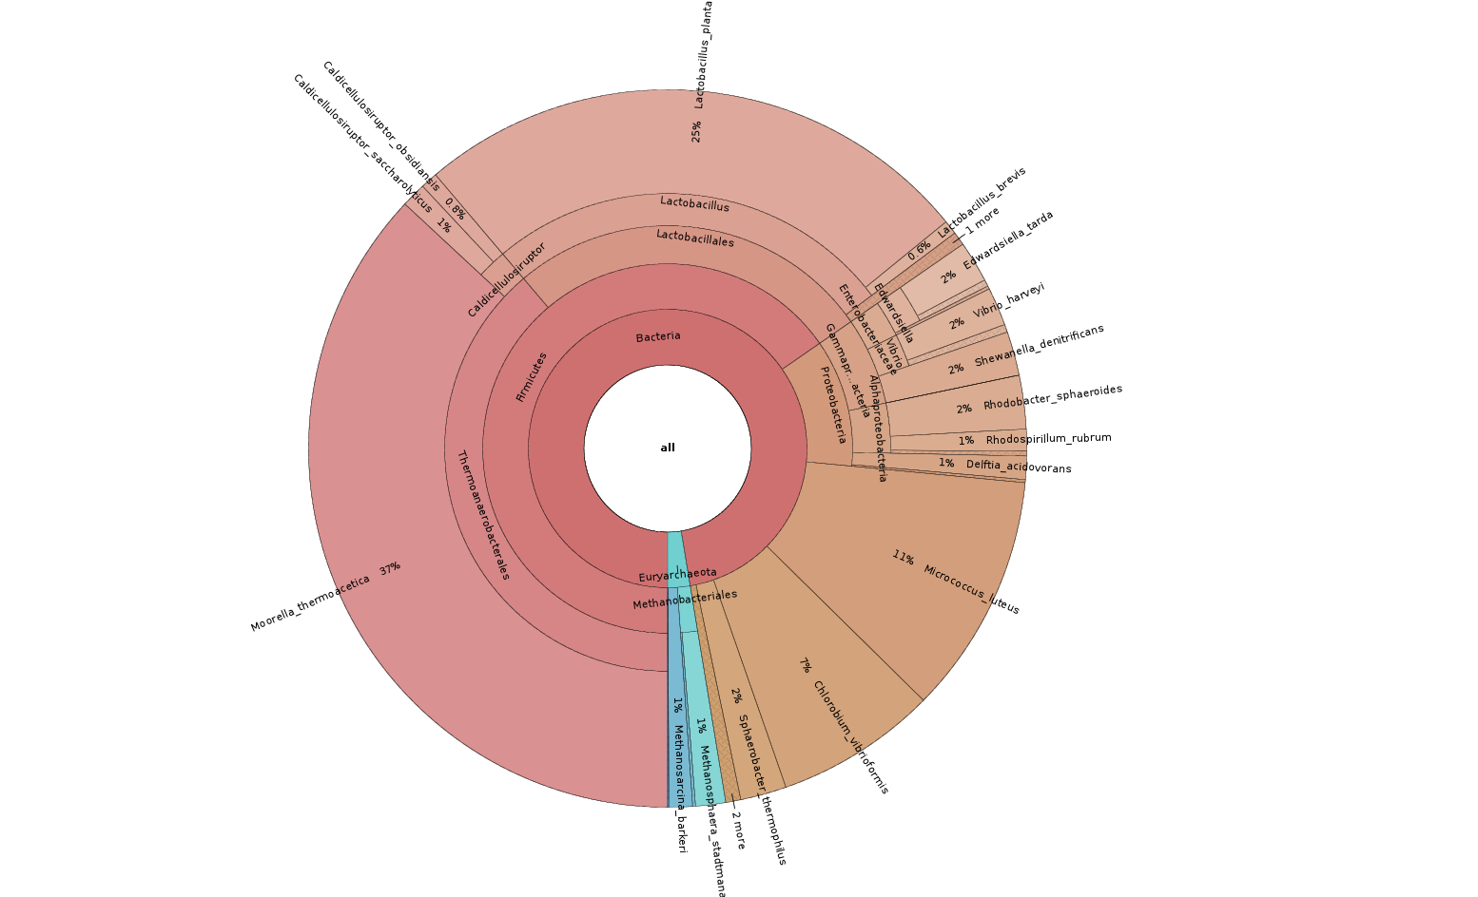
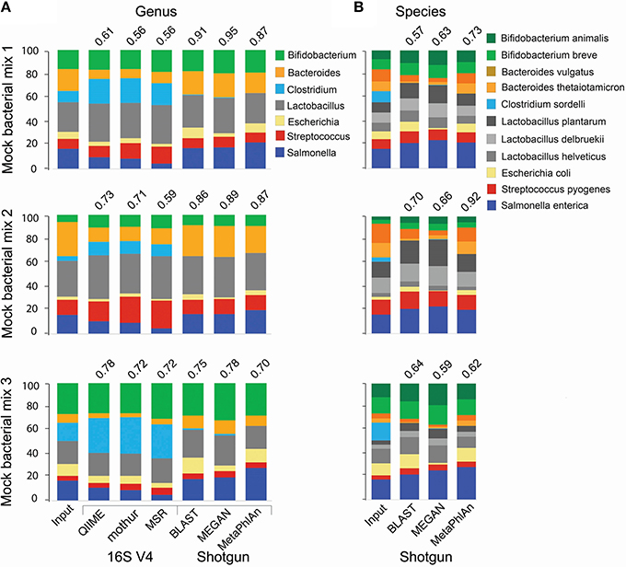
Stage 4 - Statistical analysis:
By using R language you can present you OUT cluster results in bar graphs, heat map or phylogenetic tree.

Slide 20
Thank you

